Slide 1
Lecture 5: A Survey of Model-Free Reinforcement Learning
Optimal policies for Lagrangian turbulence – Dr. Robin Heinonen
Aqtivate workshop on data-driven and model-based tools for complex flows and complex fluids
June 3-7

Slide 2
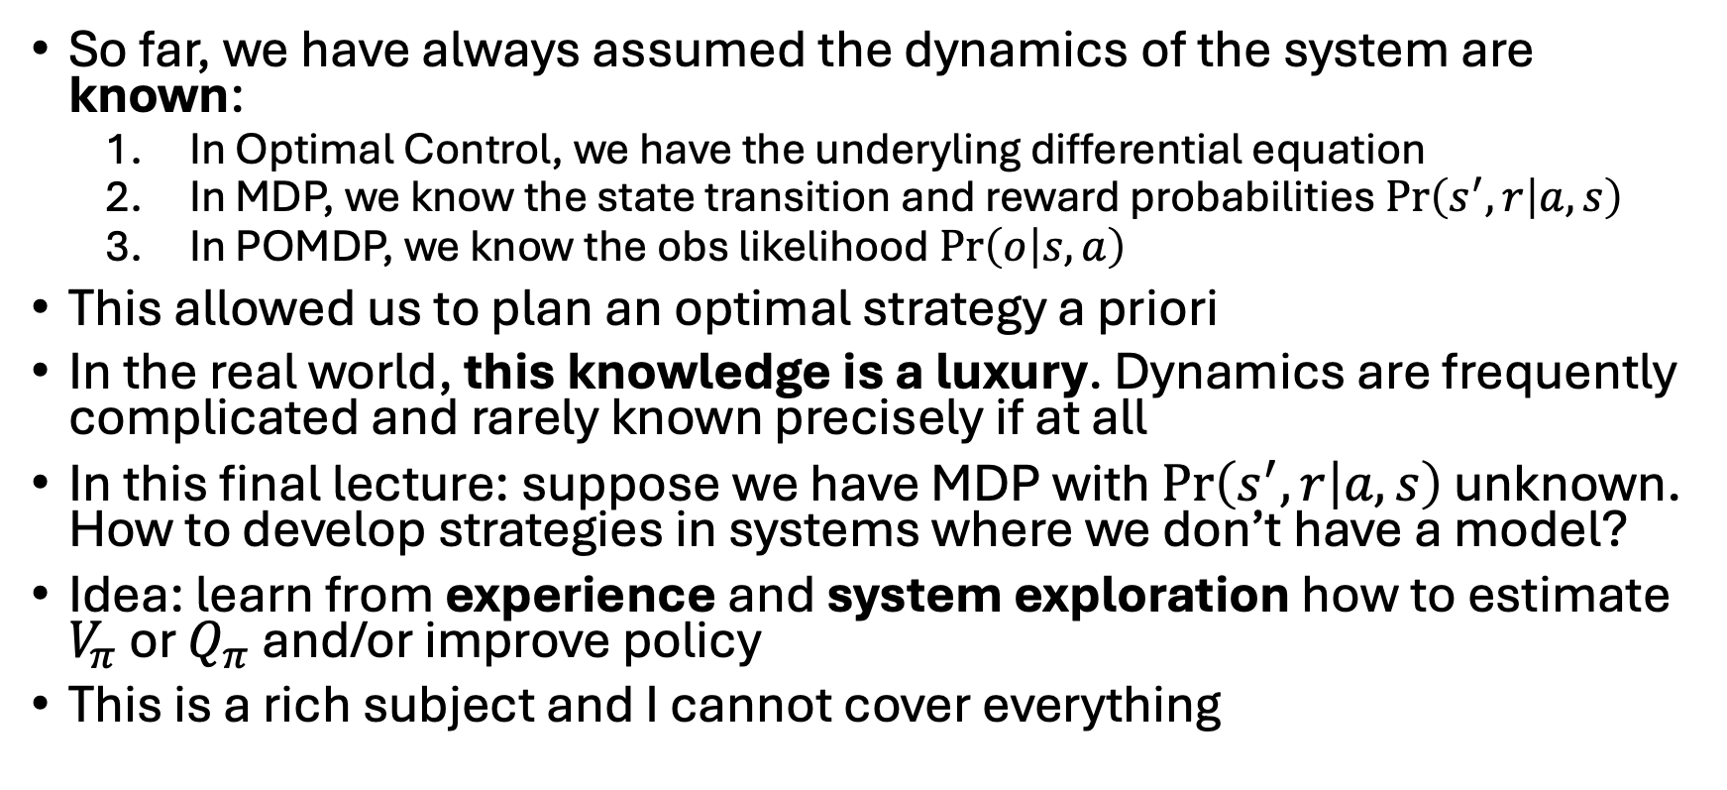
Going model-free
So far, we have always assumed the dynamics of the system are known:
In Optimal Control, we have the underyling differential equation
In MDP, we know the state transition and reward probabilities $\operatorname{Pr}\left(s^{′},r | a,s\right)$
In POMDP, we know the obs likelihood $\operatorname{Pr}\left(o | s,a\right)$
This allowed us to plan an optimal strategy a priori
In the real world, this knowledge is a luxury. Dynamics are frequently complicated and rarely known precisely if at all
In this final lecture: suppose we have MDP with $\operatorname{Pr}\left(s^{′},r | a,s\right)$ unknown. How to develop strategies in systems where we don’t have a model?
Idea: learn from experience and system exploration how to estimate $V_{π}$ or $Q_{π}$ and/or improve policy
This is a rich subject and I cannot cover everything

Slide 3
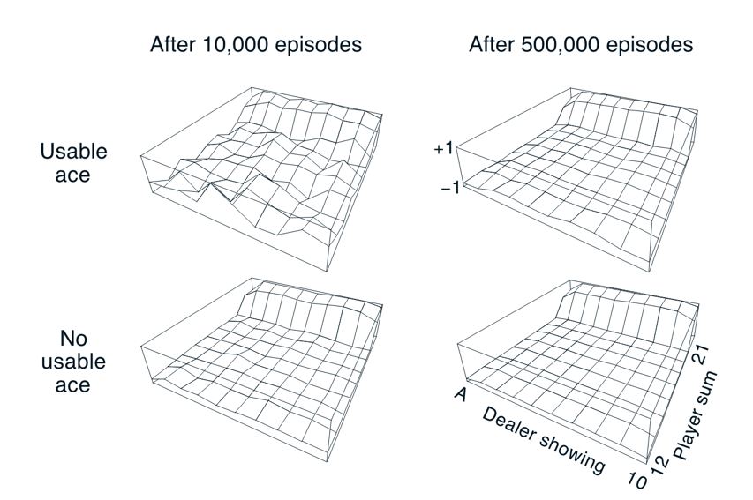
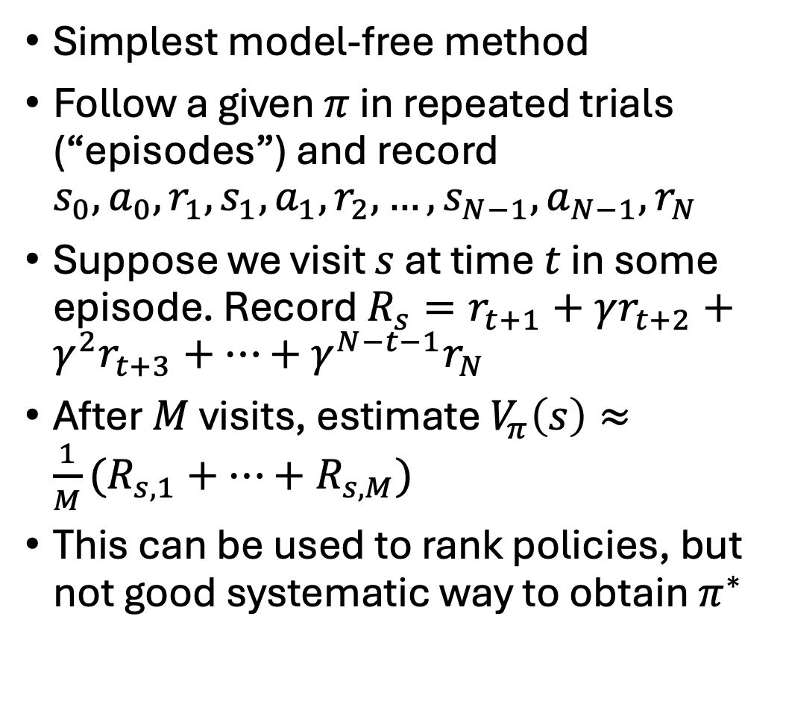
A first attempt: Monte Carlo methods
Simplest model-free method
Follow a given $π$ in repeated trials (“episodes”) and record $s_{0},a_{0},r_{1},s_{1},a_{1},r_{2},…,s_{N−1},a_{N−1},r_{N}$
Suppose we visit $s$ at time $t$ in some episode. Record $R_{s}=r_{t+1}+γr_{t+2}+γ^{2}r_{t+3}+…+γ^{N−t−1}r_{N}$
After $M$ visits, estimate $V_{π}\left(s\right)≈\frac{1}{M}(R_{s,1}+…+R_{s,M})$
This can be used to rank policies, but not good systematic way to obtain $π^{∗}$

Slide 4
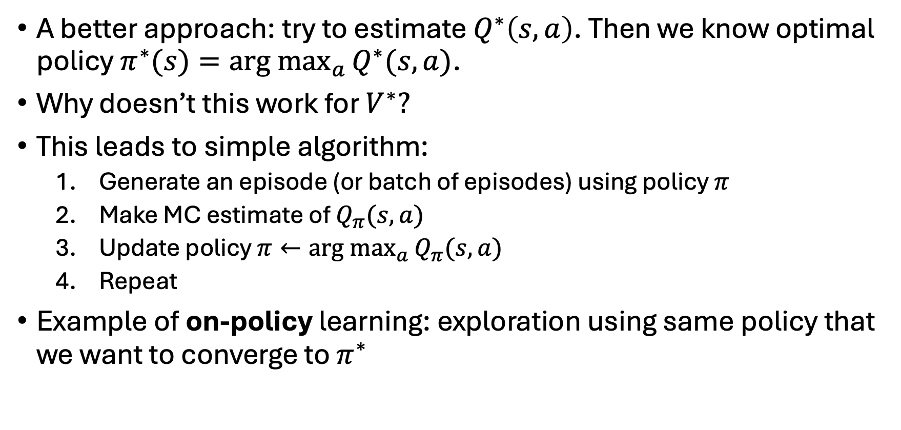
On-policy Monte Carlo
A better approach: try to estimate $Q^{∗}\left(s,a\right)$. Then we know optimal policy $π^{∗}(s)=\underset{a}{arg max}{Q^{∗}(s,a)}$.
Why doesn’t this work for $V^{∗}?$
This leads to simple algorithm:
Generate an episode (or batch of episodes) using policy $π$
Make MC estimate of $Q_{π}(s,a)$
Update policy $π←\underset{a}{arg max}{Q_{π}(s,a)}$
Repeat
Example of on-policy learning: exploration using same policy that we want to converge to $π^{∗}$
Notes:
Doesn’t work for V^* because we don’t have the dynamics. therefore don’t know how to look one step into the future and choose best a using Bellman

Slide 5
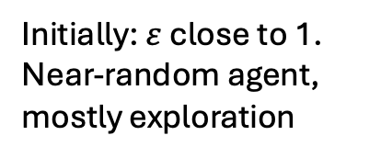
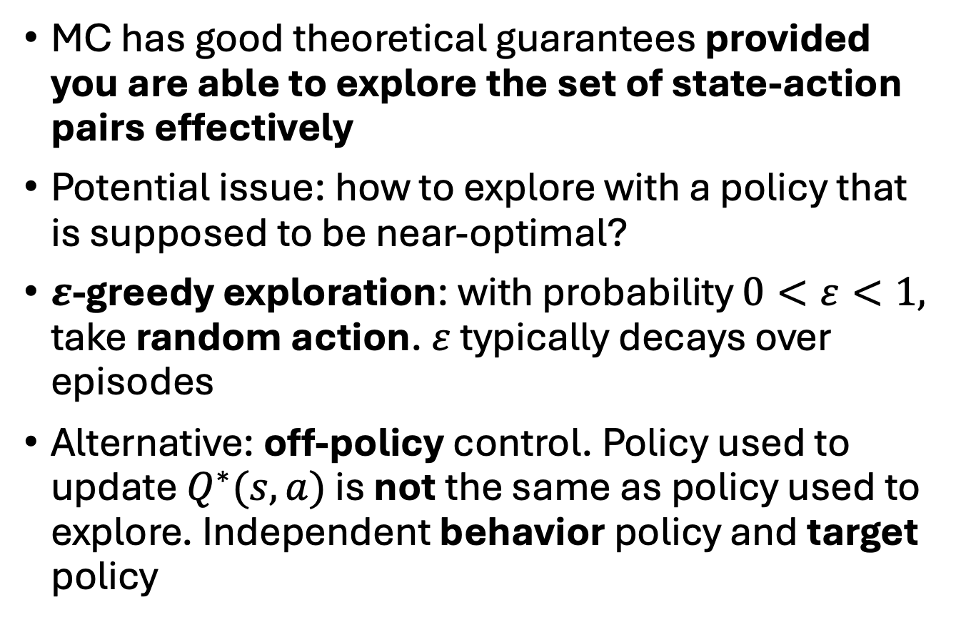
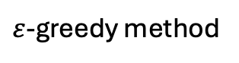
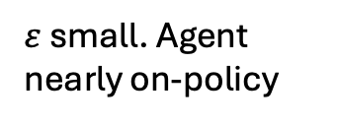
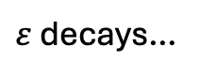
How to explore?
$ε$-greedy method
MC has good theoretical guarantees provided you are able to explore the set of state-action pairs effectively
Potential issue: how to explore with a policy that is supposed to be near-optimal?
$ε$-greedy exploration: with probability $0<ε<1,$ take random action. $ε$ typically decays over episodes
Alternative: off-policy control. Policy used to update $Q^{∗}(s,a)$ is not the same as policy used to explore. Independent behavior policy and target policy
Initially: $ε$ close to 1. Near-random agent, mostly exploration
$ε$ decays…
$ε$ small. Agent nearly on-policy
episodes

Slide 6
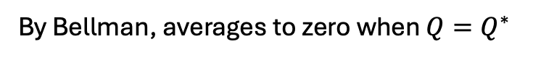
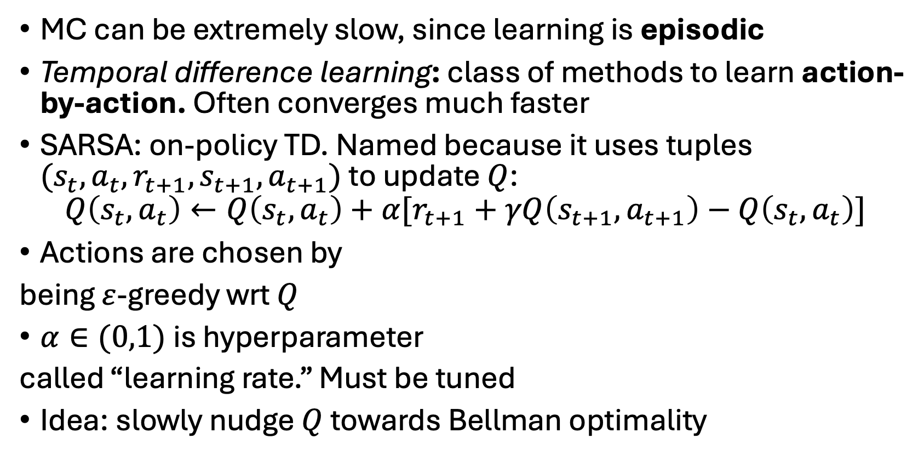
SARSA
MC can be extremely slow, since learning is episodic
Temporal difference learning: class of methods to learn action-by-action. Often converges much faster
SARSA: on-policy TD. Named because it uses tuples $(s_{t},a_{t},r_{t+1},s_{t+1},a_{t+1})$ to update $Q$:
$$Q\left(s_{t},a_{t}\right)←Q\left(s_{t},a_{t}\right)+α[r_{t+1}+γQ\left(s_{t+1},a_{t+1}\right)−Q\left(s_{t},a_{t}\right)]$$
Actions are chosen by
being $ε$-greedy wrt $Q$
$α∈(0,1)$is hyperparameter
called “learning rate.” Must be tuned
Idea: slowly nudge $Q$ towards Bellman optimality
By Bellman, averages to zero when $Q=Q^{∗}$

Slide 7
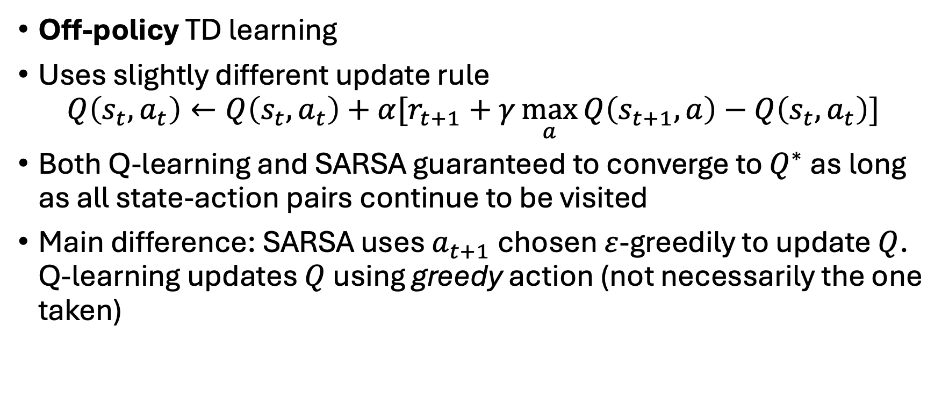
Q-learning
Off-policy TD learning
Uses slightly different update rule
$$Q\left(s_{t},a_{t}\right)←Q\left(s_{t},a_{t}\right)+α[r_{t+1}+γ\max_{a}{Q\left(s_{t+1},a\right)}−Q\left(s_{t},a_{t}\right)]$$
Both Q-learning and SARSA guaranteed to converge to $Q^{∗}$ as long as all state-action pairs continue to be visited
Main difference: SARSA uses $a_{t+1}$ chosen $ε$-greedily to update $Q$. Q-learning updates $Q$ using greedy action (not necessarily the one taken)

Slide 8
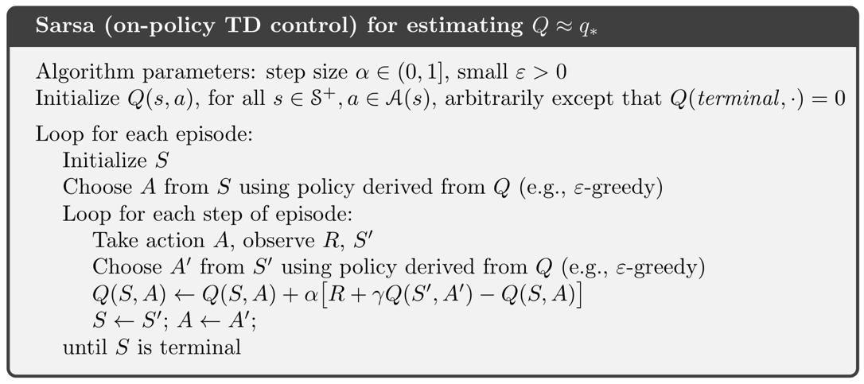
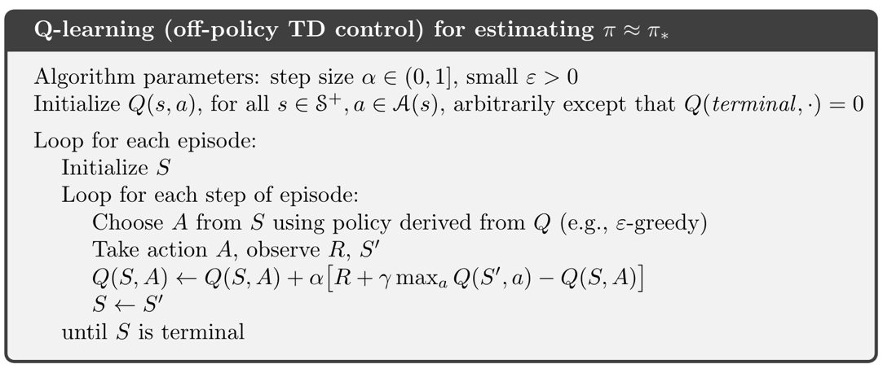
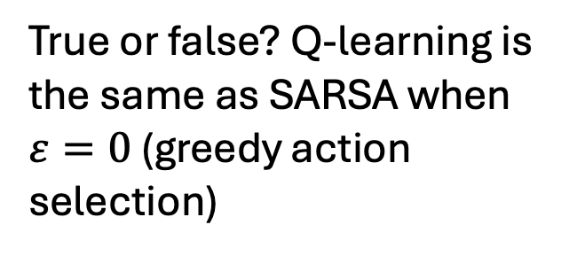
SARSA vs. Q-learning
True or false? Q-learning is the same as SARSA when $ε=0$ (greedy action selection)
False! Q-learning will not necessarily take the same action that it used in update

Slide 9
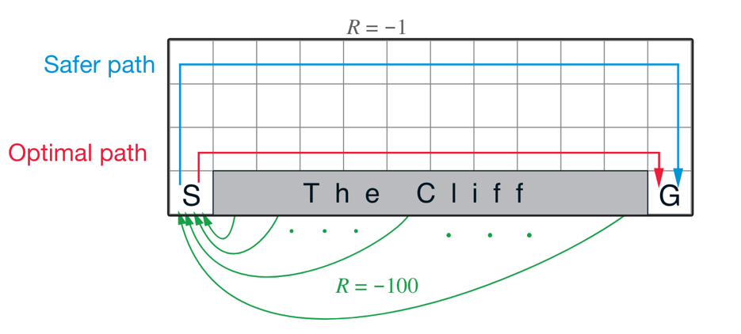
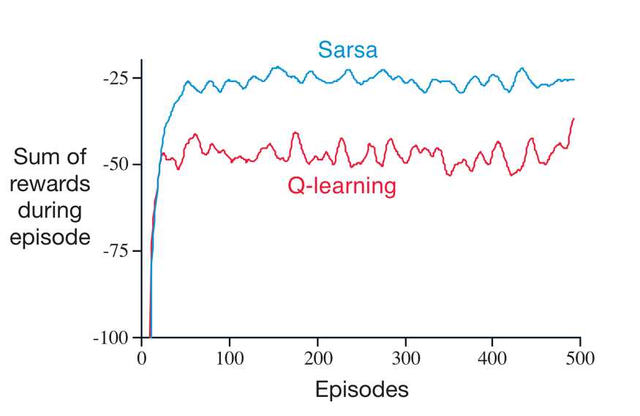
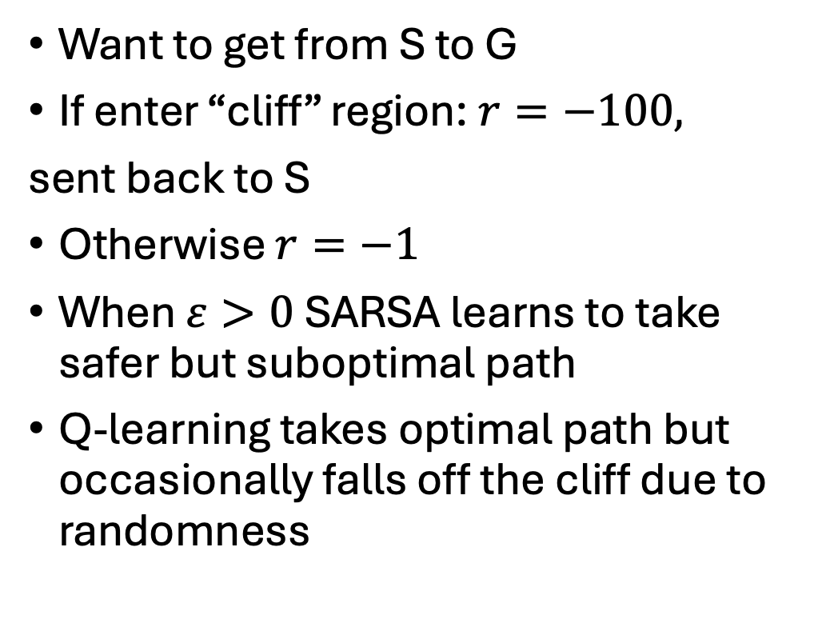
Example: cliff-walking problem
Want to get from S to G
If enter “cliff” region: $r=−100,$
sent back to S
Otherwise $r=−1$
When $ε>0$ SARSA learns to take safer but suboptimal path
Q-learning takes optimal path but occasionally falls off the cliff due to randomness
Notes:
Work out on board if students don’t understand. Consider s with y=2. For a=(0,-1), SARSA will occasionally take a’=(0,-1) with Q(s’,a’) strongly negative, meaning Q(s,a) decreases. Meanwhile Q-learning will take the optimal a’ when updating Q(s,a), so it will not devalue moving to state s’.

Slide 10
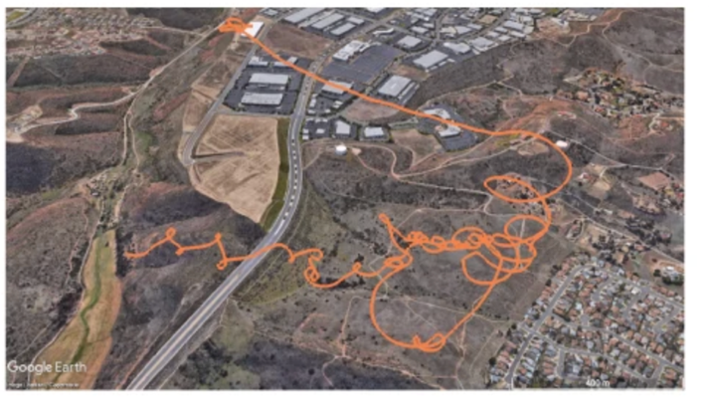
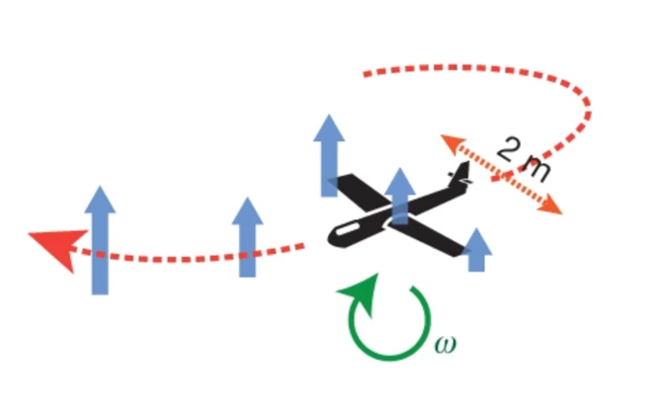
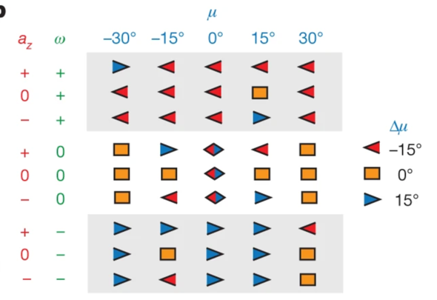
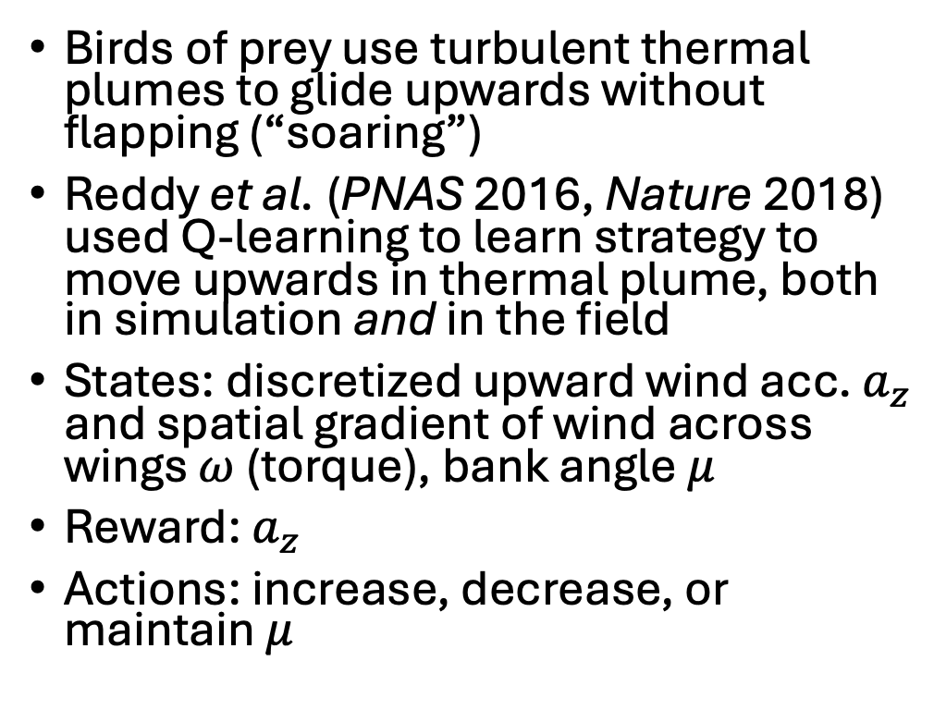
Example: learning to soar in turbulence
Birds of prey use turbulent thermal plumes to glide upwards without flapping (“soaring”)
Reddy et al. (PNAS 2016, Nature 2018) used Q-learning to learn strategy to move upwards in thermal plume, both in simulation and in the field
States: discretized upward wind acc. $a_{z}$ and spatial gradient of wind across wings $ω$ (torque), bank angle $μ$
Reward: $a_{z}$
Actions: increase, decrease, or maintain $μ$

Slide 11
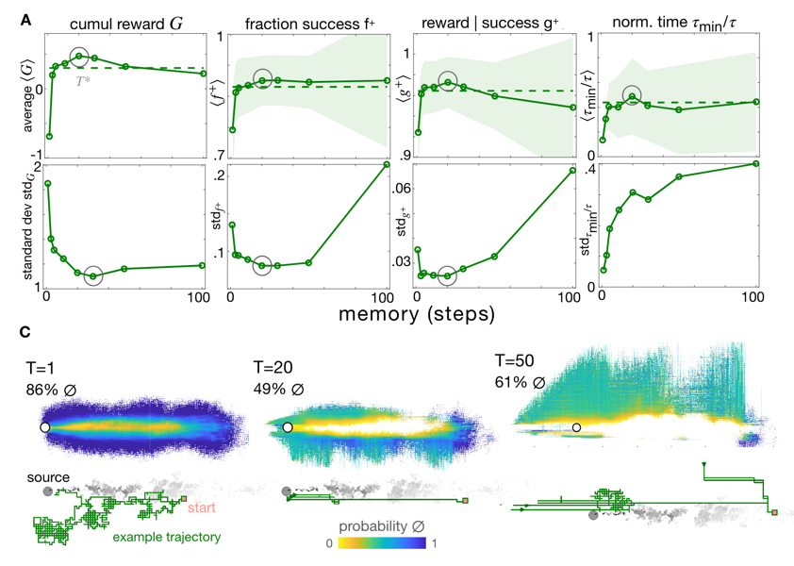
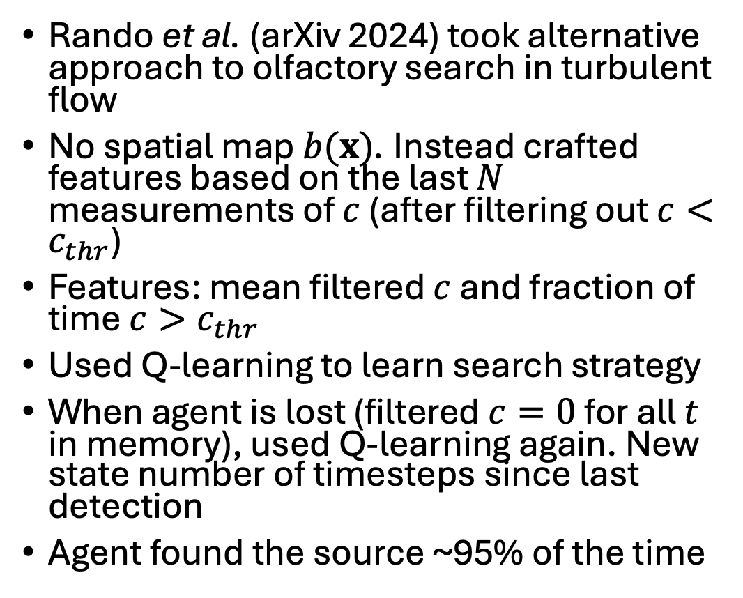
Example: olfactory search without a map
Rando et al. (arXiv 2024) took alternative approach to olfactory search in turbulent flow
No spatial map $b(x)$. Instead crafted features based on the last $N$ measurements of $c$ (after filtering out $c<c_{thr}$)
Features: mean filtered $c$ and fraction of time $c>c_{thr}$
Used Q-learning to learn search strategy
When agent is lost (filtered $c=0$ for all $t$ in memory), used Q-learning again. New state number of timesteps since last detection
Agent found the source ~95% of the time

Slide 12
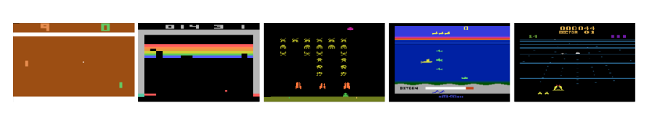
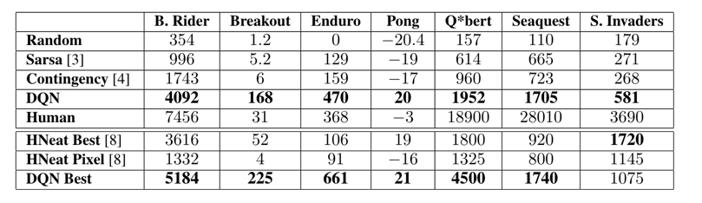
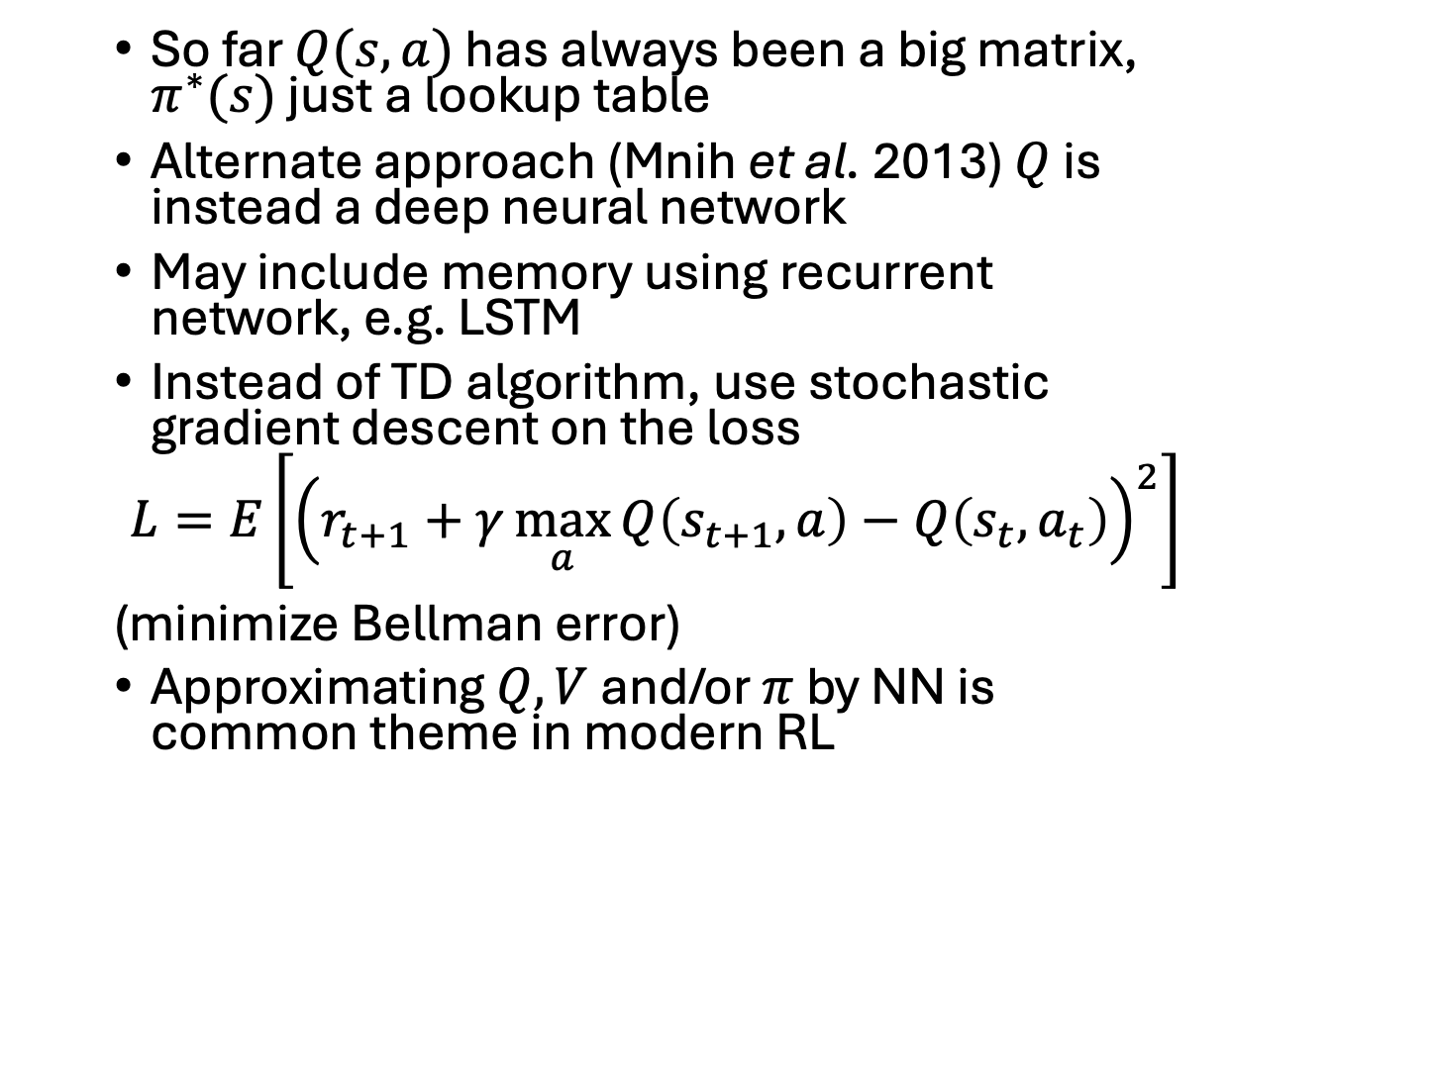
Deep Q-learning
So far $Q(s,a)$ has always been a big matrix, $π^{∗}(s)$ just a lookup table
Alternate approach (Mnih et al. 2013) $Q$ is instead a deep neural network
May include memory using recurrent network, e.g. LSTM
Instead of TD algorithm, use stochastic gradient descent on the loss
$$L=E\left.\left[{\left.\left(r_{t+1}+γ\max_{a}{Q\left(s_{t+1},a\right)}−Q\left(s_{t},a_{t}\right)\right.\right)}^{2}\right.\right]$$
(minimize Bellman error)
Approximating $Q, V$ and/or $π$ by NN is common theme in modern RL
Mnih et al used DQL to achieve then state-of-the-art performance on several Atari games

Slide 13
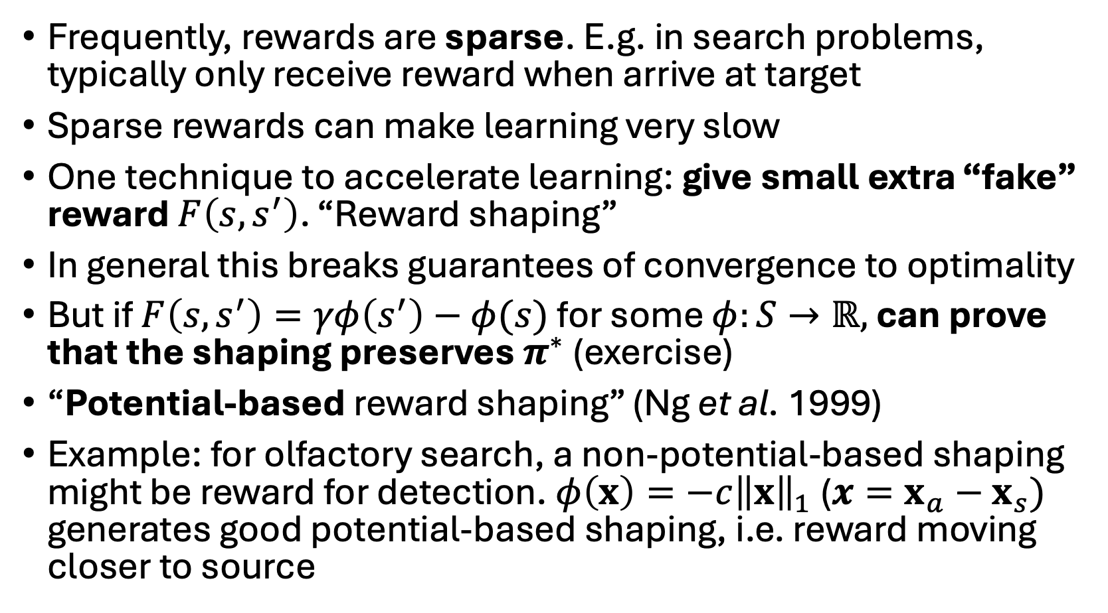
Reward shaping
Frequently, rewards are sparse. E.g. in search problems, typically only receive reward when arrive at target
Sparse rewards can make learning very slow
One technique to accelerate learning: give small extra “fake” reward $F\left(s,s^{′}\right)$. “Reward shaping”
In general this breaks guarantees of convergence to optimality
But if $F\left(s,s^{′}\right)=γφ\left(s^{′}\right)−φ(s)$ for some $φ:S→ℝ,$ can prove that the shaping preserves $π^{∗}$ (exercise)
“Potential-based reward shaping” (Ng et al. 1999)
Example: for olfactory search, a non-potential-based shaping might be reward for detection. $φ\left(x\right)=−c{\left\|x\right\|}_{1}$ ($x=x_{a}−x_{s})$ generates good potential-based shaping, i.e. reward moving closer to source

Slide 14
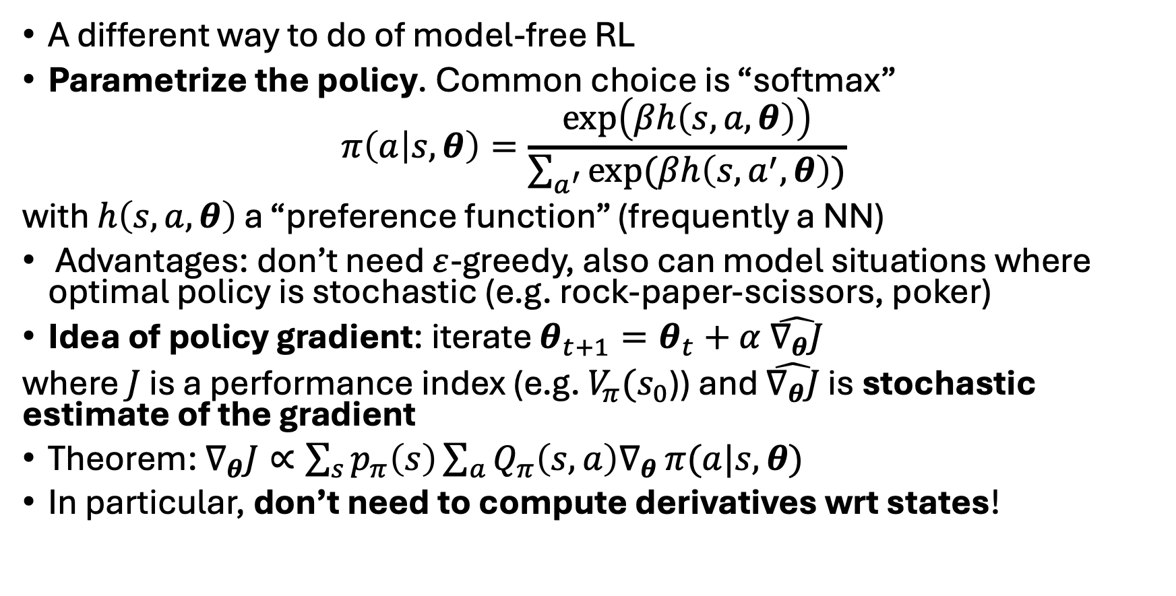
Policy gradient methods
A different way to do of model-free RL
Parametrize the policy. Common choice is “softmax”
$$π\left(a | s,θ\right)=\frac{\exp\left(βh\left(s,a,θ\right)\right)}{\sum_{a^{′}}{exp⁡(βh\left(s,a^{′},θ\right))}}$$
with $h\left(s,a,θ\right)$ a “preference function” (frequently a NN)
Advantages: don’t need $ε$-greedy, also can model situations where optimal policy is stochastic (e.g. rock-paper-scissors, poker)
Idea of policy gradient: iterate $θ_{t+1}=θ_{t}+α \hat{∇_{θ}J}$
where $J$ is a performance index (e.g. $V_{π}(s_{0}$)) and $\hat{∇_{θ}J}$ is stochastic estimate of the gradient
Theorem: $∇_{θ}J∝\sum_{s}{p_{π}\left(s\right)}\sum_{a}{Q_{π}\left(s,a\right)∇_{θ}}π(a|s,θ)$
In particular, don’t need to compute derivatives wrt states!
Notes:
it’s just a boltzmann distribution, beta is just there to underscore the connection. softmax is a misnomer: really a soft argmax. at low temperature (beta->infinity) distribution sharpens, get 1 if a maximizes, 0 otherwise. why is random policy best for poker? not exploitable!

Slide 15
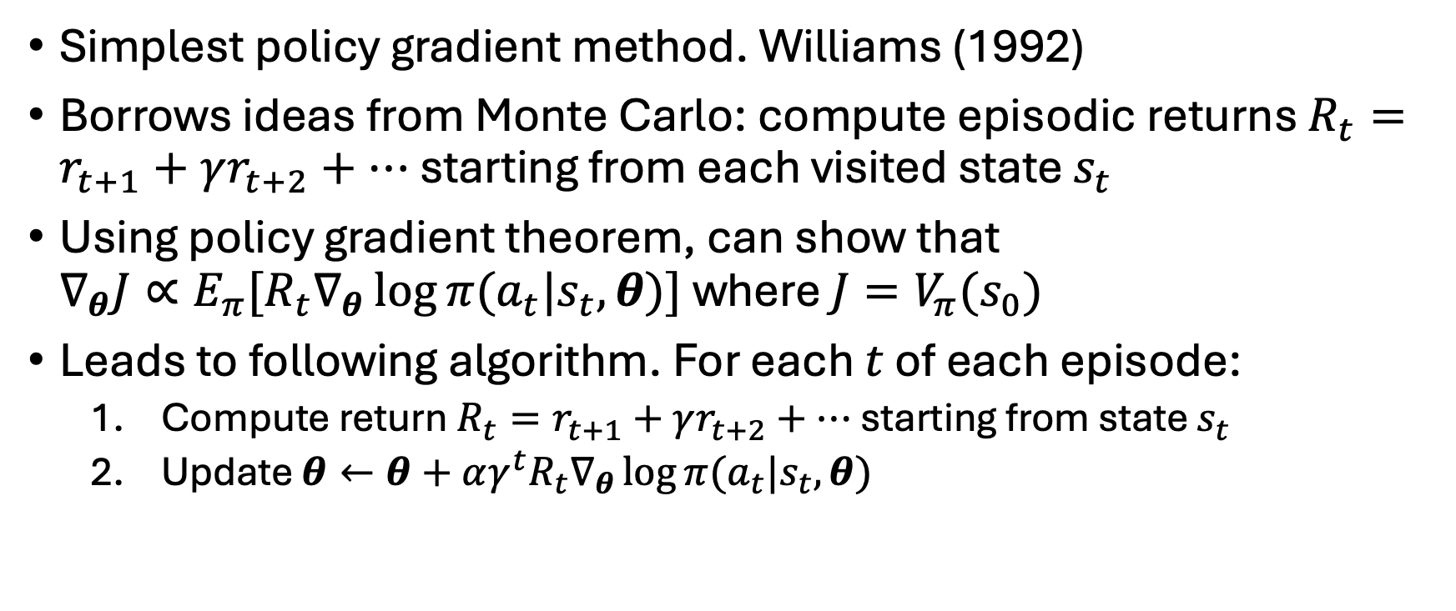
REINFORCE
Simplest policy gradient method. Williams (1992)
Borrows ideas from Monte Carlo: compute episodic returns $R_{t}=r_{t+1}+γr_{t+2}+…$ starting from each visited state $s_{t}$
Using policy gradient theorem, can show that $∇_{θ}{J∝E_{π}[R}_{t}∇_{θ}\log{π(a_{t}|s_{t},θ})]$ where $J=V_{π}(s_{0})$
Leads to following algorithm. For each $t$ of each episode:
Compute return $R_{t}=r_{t+1}+γr_{t+2}+…$ starting from state $s_{t}$
Update $θ←θ+{αγ^{t}R}_{t}∇_{θ}\log{π(a_{t}|s_{t},θ})$

Slide 16
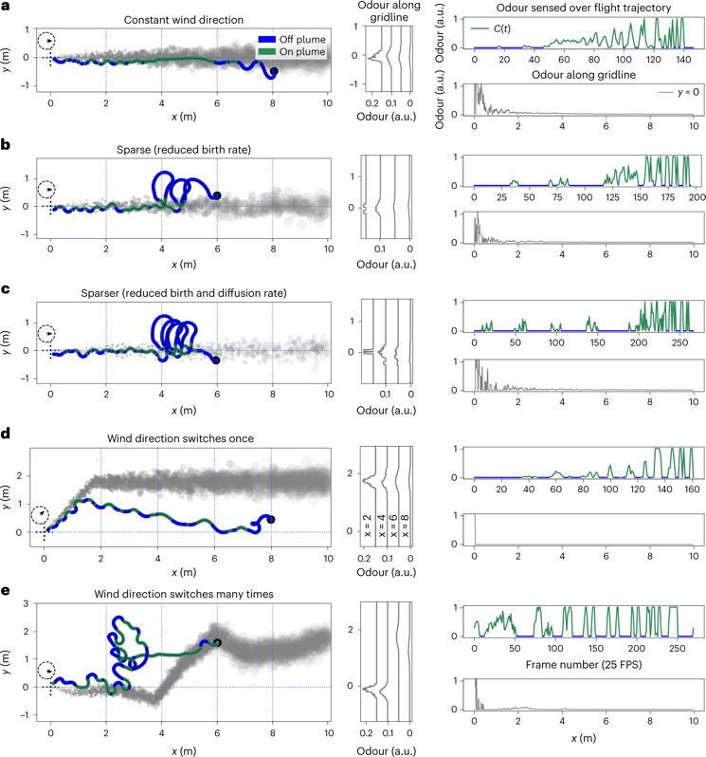
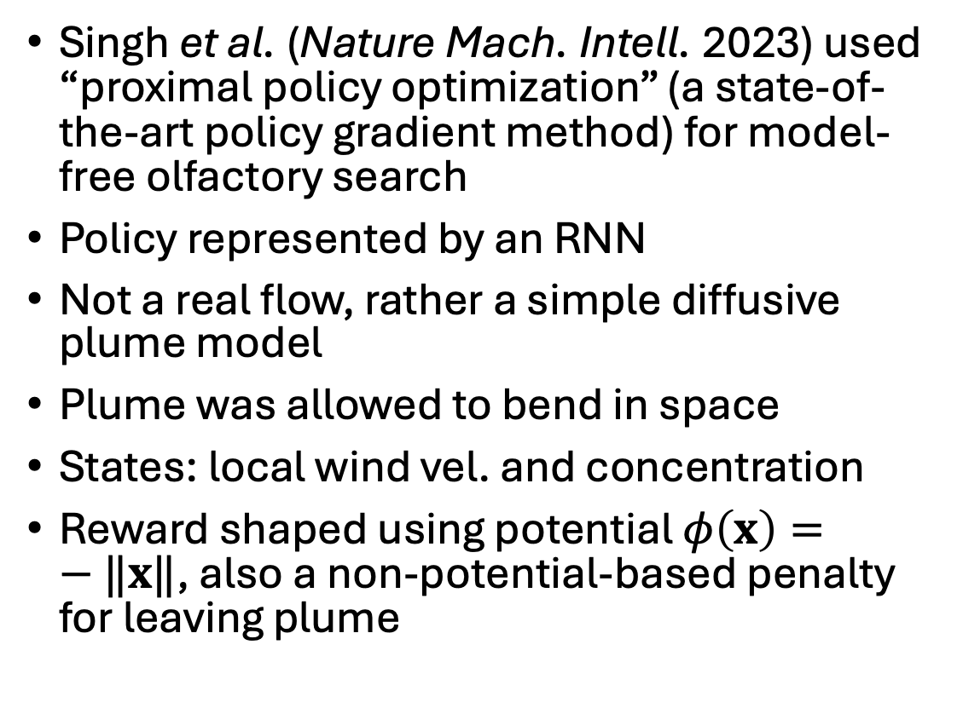
Example: model-free olfactory search
Singh et al. (Nature Mach. Intell. 2023) used “proximal policy optimization” (a state-of-the-art policy gradient method) for model-free olfactory search
Policy represented by an RNN
Not a real flow, rather a simple diffusive plume model
Plume was allowed to bend in space
States: local wind vel. and concentration
Reward shaped using potential $φ\left(x\right)=−‖x‖$, also a non-potential-based penalty for leaving plume

Slide 17
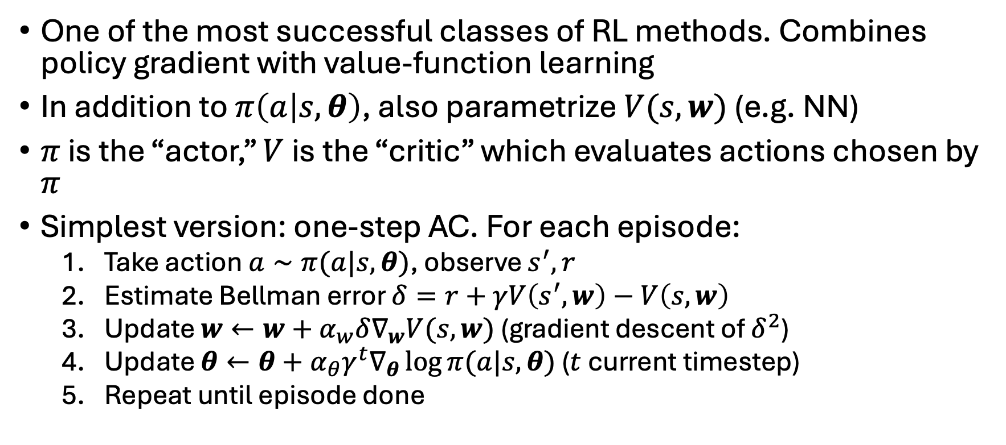
Actor-critic methods
One of the most successful classes of RL methods. Combines policy gradient with value-function learning
In addition to $π\left(a | s,θ\right)$, also parametrize $V(s,w)$ (e.g. NN)
$π$ is the “actor,” $V$ is the “critic” which evaluates actions chosen by $π$
Simplest version: one-step AC. For each episode:
Take action $a∼π(a|s,θ)$, observe $s^{′},r$
Estimate Bellman error $δ=r+γV\left(s^{′},w\right)−V\left(s,w\right)$
Update $w←w+α_{w}δ∇_{w}V(s,w)$ (gradient descent of $δ^{2}$)
Update $θ←θ+α_{θ}γ^{t}∇_{θ}\log{π(a|s,θ)}$ ($t$ current timestep)
Repeat until episode done

Slide 18
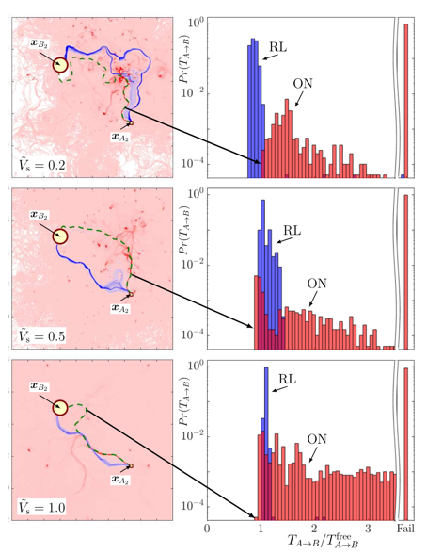
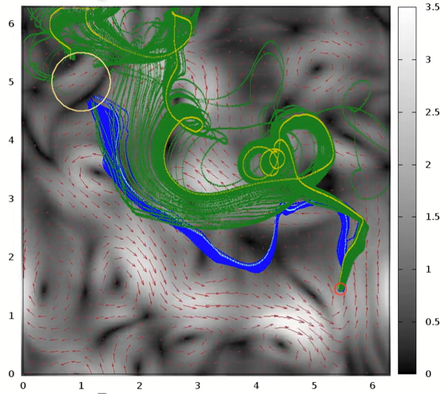
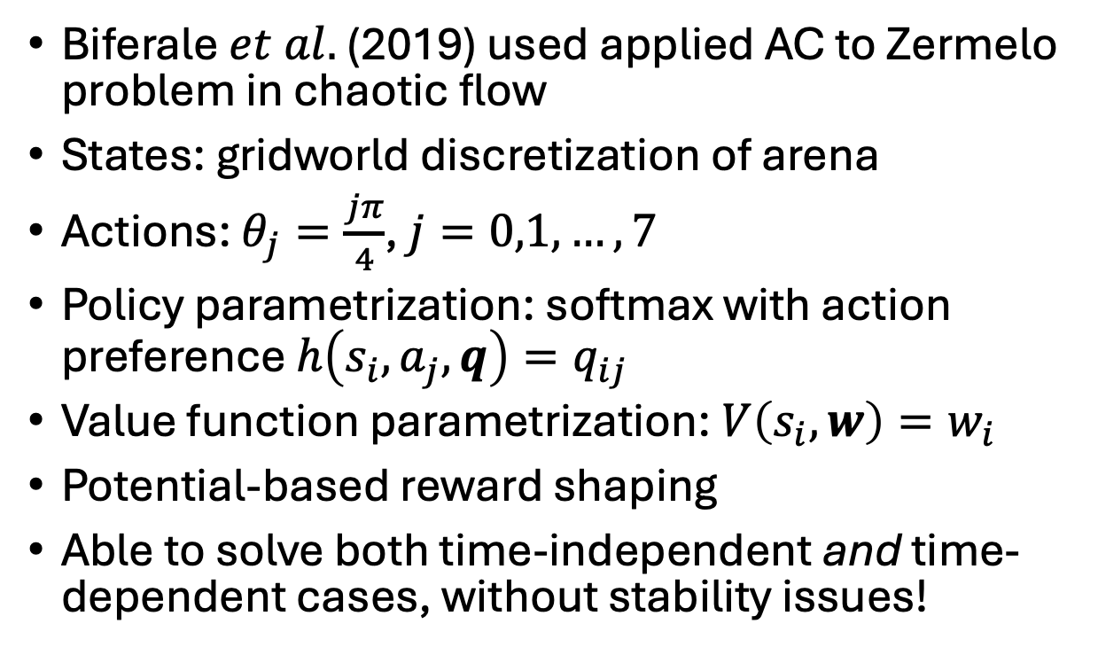
Example: Zermelo problem
Biferale $et al.$ (2019) used applied AC to Zermelo problem in chaotic flow
States: gridworld discretization of arena
Actions: $θ_{j}=\frac{jπ}{4}$, $j=0,1,…,7$
Policy parametrization: softmax with action preference $h\left(s_{i},a_{j},q\right)=q_{ij}$
Value function parametrization: $V\left(s_{i},w\right)=w_{i}$
Potential-based reward shaping
Able to solve both time-independent and time-dependent cases, without stability issues!
Notes:
these simple parametrizations possible because we have a finite states and actions

Slide 19
Conclusion
Powerful tools exist for decision making when the dynamics are unknown
Modern methods marry model-free RL with NNs for function approximation
Challenge: need to choose algorithm, hyperparameters, set of states, reward + shaping. Best choices not always obvious, often more art than science
Also: training may take a very long time and is not always very stable

